Slide 1

SmartCrop – AI & IoT-Based Crop Suitability and Monitoring System
By
Zulkifl Ahmad SP23-BCS-047 Aleeza Javed SP23-BCS-141 Muneeba Kalsoom SP23-BCS-147
Supervisor : Sir Yasar Khan
Department of Computer Science
COMSATS University Islamabad, Abbottabad Campus

Slide 2
Agenda of the Presentation
Motivation
Brief Introduction
Scope
Functionalities
Proposed Tools / Platform
Feasibility (Technical, Financial, Resource, Operational)
Schedule – Gantt Chart
Tasks for 1st Iteration (30%)
Conclusion
2

Slide 3
Motivation
The Problem:
Farmers in Pakistan rely on experience rather than data to decide which crops to grow
Poor knowledge of soil parameters (pH, NPK, moisture) leads to wrong crop selection
Lack of real-time monitoring causes poor irrigation decisions and reduced yield
Financial loss due to crop failure is a major challenge for rural farmers

Slide 4
Motivation
Why It Matters (Utilitarian Aspect):
Pakistan's economy is heavily dependent on agriculture
A data-driven system can directly improve crop yield and farmer income
IoT + AI can replace guesswork with accurate, real-time recommendations
Automating irrigation saves water and reduces manual effort
The Gap:
Existing systems either show sensor data or predict crops - none integrate both
No current solution combines real-time monitoring + AI recommendation + automatic control + mobile alerts in one platform
SmartCrop bridges this gap.

Slide 5
Brief Introduction
What is SmartCrop?
An AI and IoT-based intelligent crop suitability and monitoring system
Helps farmers make data-driven agricultural decisions
How it Works:
IoT sensors collect real-time soil and environmental data (pH, NPK, moisture, temperature, humidity)
AI model analyzes the data and recommends the most suitable crop (wheat, rice, maize, cotton, tomato)
Mobile app displays live readings, smart alerts, and actionable recommendations
Goal:
Optimize crop yield and field health by combining IoT, AI, and automation into one integrated platform.

Slide 6
Scope
What to do
Develop an IoT-based system for real-time soil and environmental monitoring
Monitor real-time soil parameters (pH, NPK, moisture, temperature, humidity, rain, light)
Implement AI model for crop recommendation based on soil and weather data
Design a mobile application for live monitoring and alerts
Store and manage data using Firebase cloud database
Send smart alerts for critical conditions (low moisture, high temperature, rain detected)
Enable automatic irrigation control using sensor data
Support crops: Wheat, Rice, Maize, Cotton, Tomato

Slide 7
Scope
What not to do
No disease detection or pest identification
No large-scale industrial or commercial farming deployment
No web-based dashboard (mobile app only)
No offline AI prediction (requires internet/cloud connection)
No autonomous farming machinery (e.g., tractors/robots)

Slide 8
Functionalities
1. Real-Time Soil & Environmental Monitoring
Continuously reads pH, NPK, soil moisture, temperature, humidity, rain, and light (LDR) via IoT sensors
2. AI-Based Crop Recommendation
ML model predicts the most suitable crop based on current soil and weather conditions
3. Smart Alerts & Notifications
Sends real-time alerts for critical conditions — low moisture, high temperature, rain detected, nutrient deficiency
4. Mobile Application (Flutter)
Live sensor dashboard, crop recommendations, alerts, and historical data trends — all in one app

Slide 9
Functionalities
5. Cloud Data Storage & History (Firebase)
All sensor readings stored in real-time, supports historical trend tracking and analysis
6. Automatic Irrigation Control
Actuator-based system auto-triggers water supply when soil moisture drops below threshold
8. Plant Condition Reporting
Generates comprehensive reports on field/plant status to support informed farmer decisions

Slide 10
Proposed Tools/Platform
Microcontroller | ESP32 / ESP8266
Sensors | Soil moisture, pH, NPK, DHT11/DHT22, rain sensor, LDR
Programming | Python, C++ (Arduino IDE)
AI/ML | Scikit-learn / TensorFlow
Mobile App | Flutter
Database / Cloud | Firebase
Development Tools | VS Code, Arduino IDE

Slide 11
Feasibility
Technical feasibility
Required technologies (IoT, AI, Mobile App, Cloud) are well-established and widely used.
ESP32/ESP8266 supports sensor integration and real-time data transmission.
Sensors (pH, NPK, moisture, temperature, humidity) are compatible and easy to interface.
AI model can be developed using Python with Scikit-learn or TensorFlow.
Firebase enables real-time database and cloud integration.
Flutter supports cross-platform mobile app development.
System integration between hardware, cloud, and mobile app is technically achievable.

Slide 12
Feasibility
Financial feasibility
Uses low-cost components (ESP32, basic sensors)
Open-source tools (Python, Flutter, Arduino IDE) → no license cost
Cloud (Firebase) has free tier for development
Estimated prototype cost is affordable for students
Overall project is cost-effective and economically viable

Slide 13
Feasibility
Resource feasibility
All required hardware components (ESP32, sensors, actuators) are easily available.
Necessary software tools (Arduino IDE, Python, Flutter, Firebase) are accessible and mostly free.
The project can be developed using standard computers/laptops.
Internet connectivity is available for cloud integration and data storage.
Team members have basic knowledge of programming and development tools.
Sufficient time and effort can be allocated to complete the project.
Required datasets for training the AI model are available.

Slide 14
Feasibility
Operational feasibility
Easy-to-use mobile app interface for farmers
Real-time alerts improve decision making
Reduces manual monitoring effort
Provides automated recommendations for crops
Requires minimal training for users
Suitable for agricultural environments
Improves efficiency and productivity

Slide 15
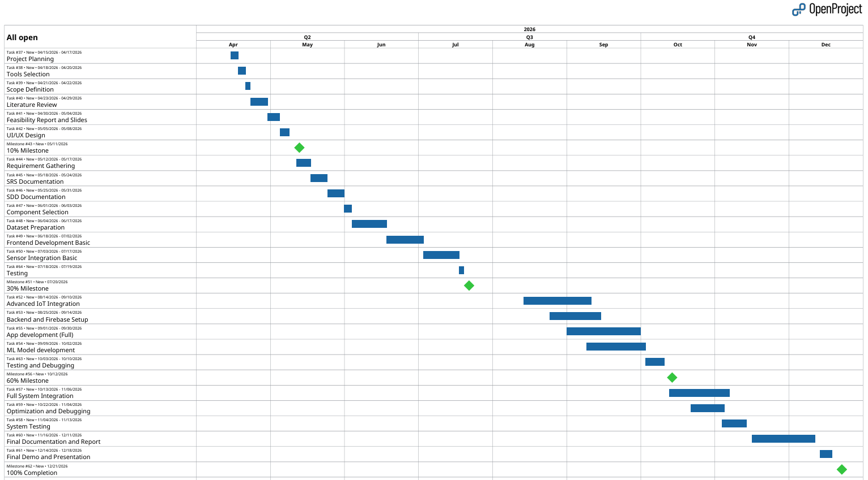
Schedule (Gannt Chart)

Slide 16
Tasks for 1st Iteration (or 30%)
Requirement Gathering
SRS Documentation
SDD Documentation
Component Selection
Dataset Preparation
Frontend Basic Development
Sensor Basic Integration

Slide 17
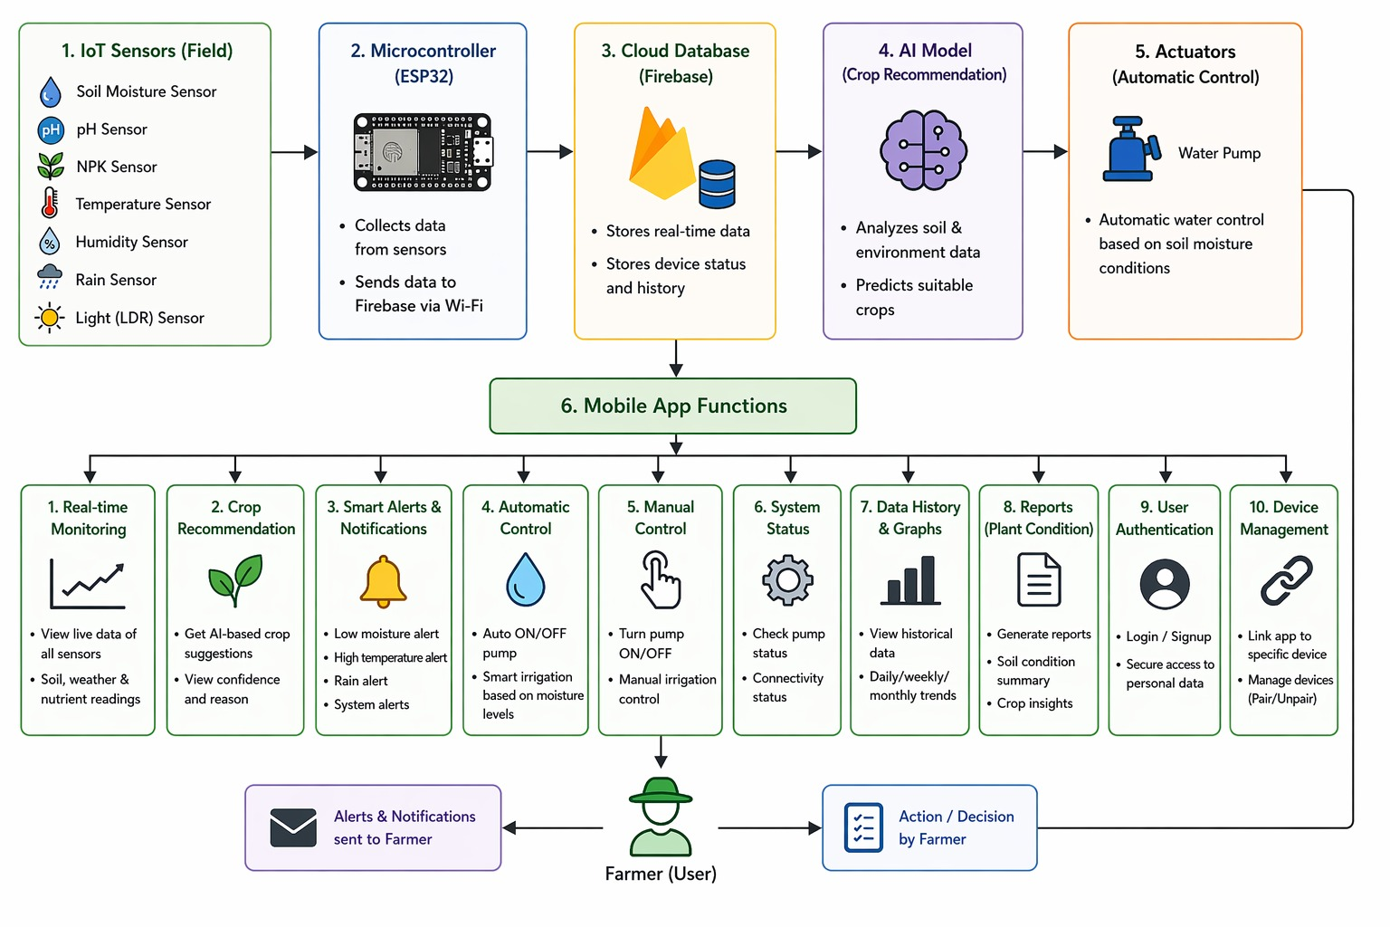
Workflow Diagram

Slide 18
Conclusion
SmartCrop combines IoT and AI to support smart farming decisions.
It monitors soil conditions in real time and recommends suitable crops.
Automatic water control improves irrigation efficiency.
Alerts and reports help farmers manage their fields easily.
Overall, it is a simple, smart, and cost-effective farming solution.

Slide 19
Thank You

